Slide 1
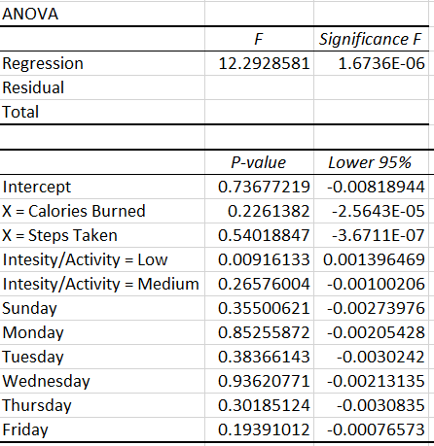




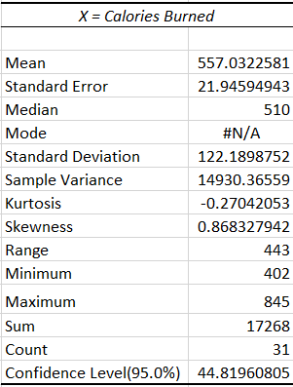
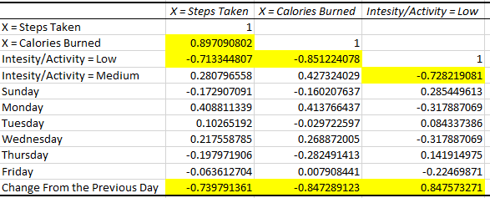

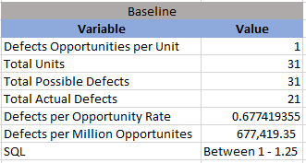
Process Improvement Project – Weight Loss Optimization
Process owner: David Doman
Key Dates --->
Define
4/13
Measure
4/16 – 5/16
Analyze
5/17 – 5/21
Improve
5/22 – 6/4
DEFINE
Not a Good Trend!
MEASURE
ANALYZE
IMPROVE
Since starting Grad school my weight has increased due to less time to workout/exercise.
Keeping up this type of lifestyle can be very detrimental to my current and future health.
Current practices are affecting my performance in my job and in my school work. Over time this will affect my potential future earnings.
If workout is low, it must go
Mean calories burned is too low!
Before
After
CONTROL
SQL=1-1.25

Slide 2
Define
Project Overview
Problem Statement: Since starting Grad School, I have not been getting enough exercise and this has resulted in gaining weight. Adding study/coursework into my schedule has diminished time that was previously spent on exercise. I know that this is a problem due to added weight and not feeling as healthy as I once did before school started. I’ve also researched the recommended time that should spent on active movement according to reputable sources such as the Centers for Disease Control and Prevention (CDC), U.S. Dept. of Health and Human Services (HHS), etc. Furthermore, data collected by my Apple Watch has shown a noticeable decrease in steps taken as well as other data.
Business Impact: There are many reasons why this problem needs to be fixed. The most obvious and important is overall health. Continuing with the current routine will lead to health issues in the future. These health problems can end up being extremely expensive due to medication costs, doctor/hospital costs, etc. Furthermore, the immediate impact to fixing this problem includes feeling better/healthier, increased productivity, better focus, etc. This in turn will result in better schoolwork and will lead to better grades. Better grades will lead to potentially landing a better job, which most likely leads to a higher income. With all of these immediate and future benefits to increasing exercise, as well as, what it could mean for future costs due to health issues, it is very difficult to quantify in dollars what this could save me. Considering increased income over the remainder of my life and avoiding very high health care costs, the increase in exercise could easily be worth at least $200,000. Success will ultimately be measured by weight loss. This will be my key output and will be a result of various inputs.
Goals: My improvement objectives include increasing the number of steps I take in daily. Another objective is to burn at least 600 calories daily. I will have categories by the type of exercise. These exercise types will be: High Intensity, Medium Intensity & Low Intensity. High Intensity will be Running, Lifting Weights and Playing sports that require high stamina. Medium will include jogging, sit-ups/push-ups and playing sports that require less stamina (Baseball for example). Low Intensity will include Walking, Yoga and sports like Golf. I will aim to spend at least 1 hour a day, 2 days a week on High Intensity, 1.25 hours a day, 3 days a week on Medium Intensity and 2 hours a day, 2 days a week on Low Intensity. Ultimately, I would like to lose 6 pounds over the next month.

Slide 3
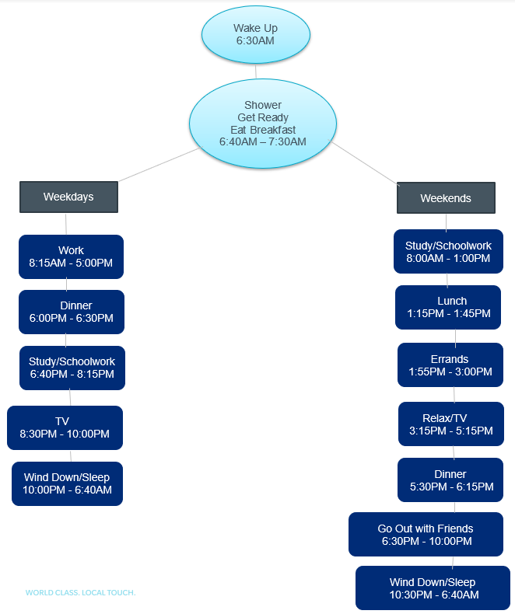
Define
Project Overview Continued
Project Scope: I am limited to utilizing the data collected by my Apple Watch and the data that it tracks. Each day will be a separate record and the boundaries for this project will start from when I wake up the morning until the moment I got to bed at night. I will also weigh myself on the start date and track my weight daily. What will not be within the scope of this project is tracking the types of food consumed and calorie intake.

Slide 4
Define
Sigma Quality Level
A defect is defined as:
Not burning 600 or more calories per day.
For the SQL calculation, this will be the only defect opportunity.
I’ve calculated a current process DPMO value of 677,419.35, which equates to a Sigma Level of between 1 and 1.25.
This is a very poor Sigma Level for the current process and tells me there are issues in the current process.

Slide 5
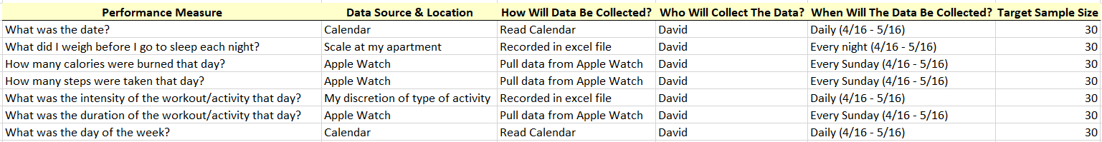
Measure
Data Measurement Plan
After analyzing the data I’ve gathered, I thought it may be beneficial to also look at change in weight by day, in addition to looking at just weight by day as my y-variable.
This calculated y-variable will be shown in some of the following slides.

Slide 6
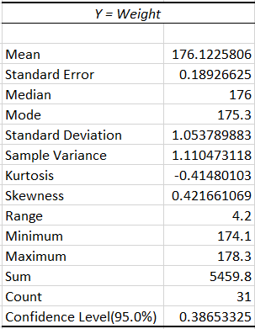
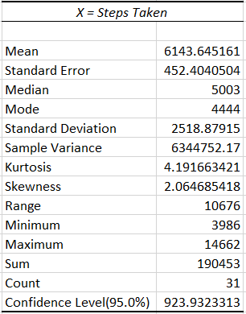
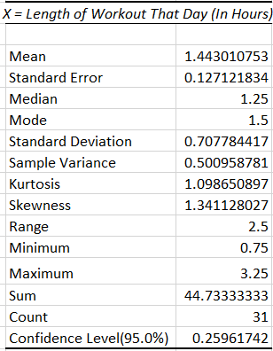
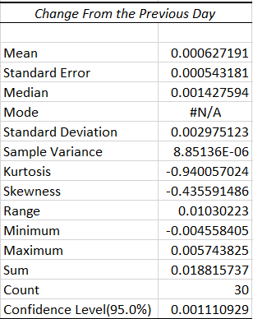
Measure
Descriptive Statistics of Data
Shown above are the descriptive statistics for the y-variable along with the descriptive statistics for the continuous input variables.
I did not include the discrete variables because it would not provide any real meaning.
Stated prior, I included the “Change from the Previous Day” because I thought it would be beneficial to show a different perspective to which inputs contributed to weight loss.

Slide 7
Measure
Visualizations of Data
As shown, Low workouts were overwhelmingly my most popular choice of intensity type. Medium was second with High being the least frequent.
Even though steps for low workouts were the highest (mainly due to being the most frequent workout), Medium and High workout steps were proportionally higher compared to the count of workouts.
The trend graph shows that there are some ups and downs within my weight but the overall the trend is increasing from the start of the study.

Slide 8
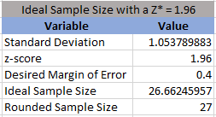
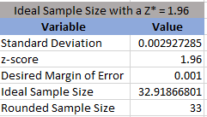
Analyze
Ideal Sample Size
I can estimate the population mean for the response variable to within 0.4 lbs. with 95% confidence.
I did the same thing when looking a change in weight by day:
I can estimate the population mean for the response variable to within 0.001 with 95% confidence.
The results from these Sample Size Tests show that my current sample size of 31 is sufficient for this analysis.

Slide 9
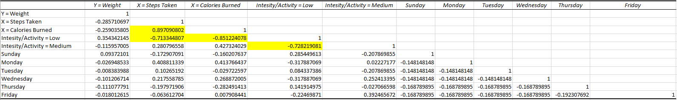
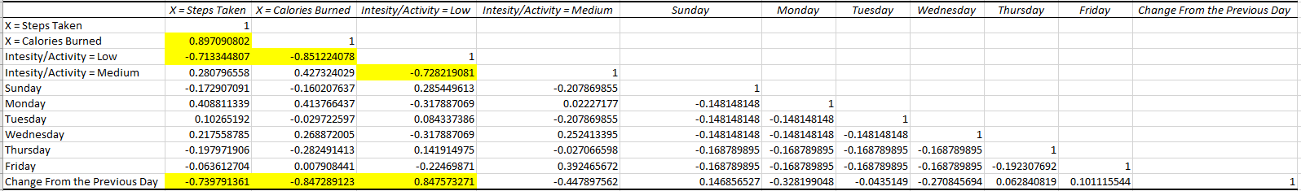
Analyze
Correlation Matrix
Correlation Matrix based of weight as the output
Correlation Matrix based of weight change as the output
Above is a correlation matrix for both weight as my output and weight change by day.
I included the weight change by day because I felt it was beneficial to analyze the data this way and I believe the results confirm that.
Steps Taken and Calories burned are highly correlated, which makes a lot of sense.
The correlation matrix with weight loss by day showed strong correlation with variables I expected (Steps Taken, Calories Burned, Intensity/Activity).

Slide 10
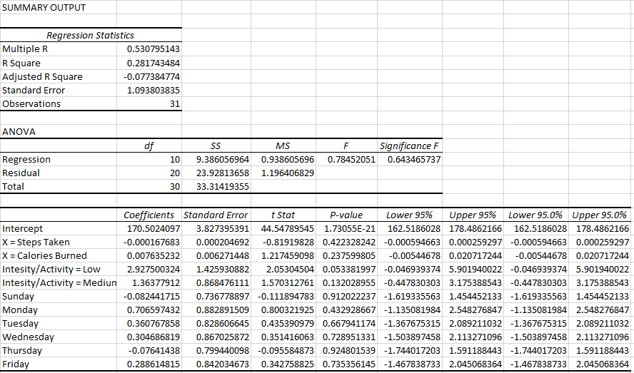
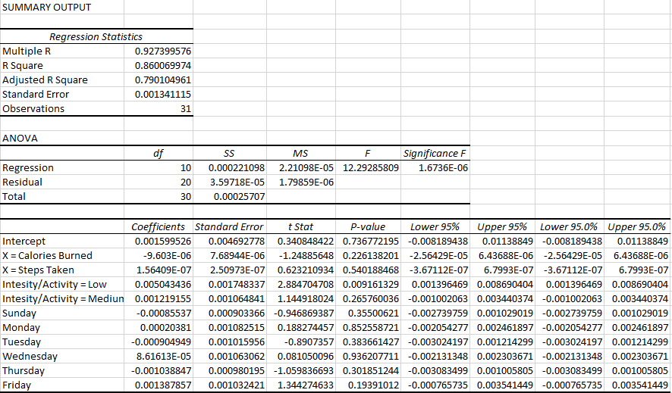
Analyze
Multiple Linear Regression
Weight Weight Change by Day
I first ran the regression with weight as my y-variable.
After thinking about it, I thought it would make more sense to run the regression based on the % change in weight from the prior day based on the input values for that day.
This resulted in an ANOVA p-value that is very favorable.
Although, I did not really see any p-values that were significant from the Multiple Linear Regression Analysis.
Intensity seemed to be the best predicter with p-values between 0.05 - 0.15.

Slide 11
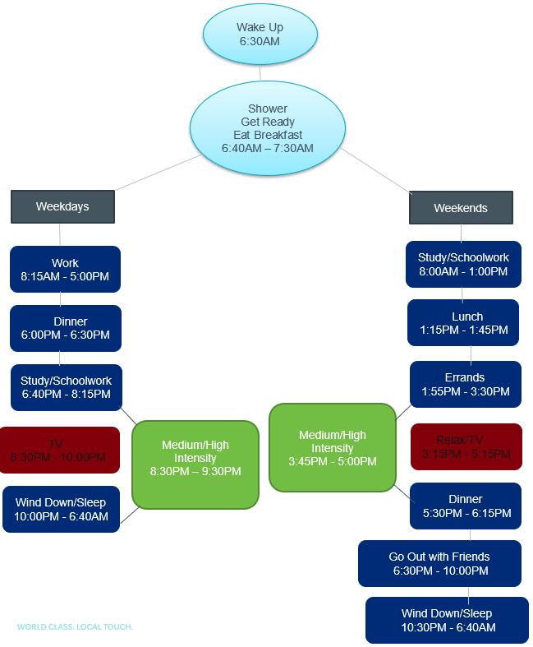
Improve
Process Map (Post-Improvement)
The improvement I made was to cut down on TV and relax time to make sure I was able to get a Medium/Hard workout in per day.
The evidence shows this has made a drastic difference in the amount of weight I lose each day.

Slide 12
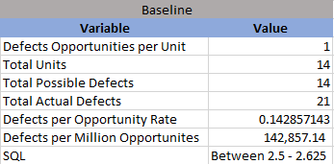
Improve
Sigma Quality Level (Post-Improvement)
A defect is defined as:
Not burning 600 or more calories per day.
For the SQL calculation, this will be the only defect opportunity.
I’ve calculated the improved process DPMO at a value of 142,857.14, which equates to a Sigma Level of between 2 and 2.625.
This is a much better improvement from the original Sigma Level of around 1.

Slide 13
Improve
Visualizations of Data (Post-Improvement)
The post-improvement changes have shown sunstantial results in weight loss.
Making sure my workout is either a Medium or High activity has been key to weight loss shown by the chart above.
High intensity workouts have resulted in more total steps even though they are less frequent on daily basis compared to Medium workouts.

Slide 14
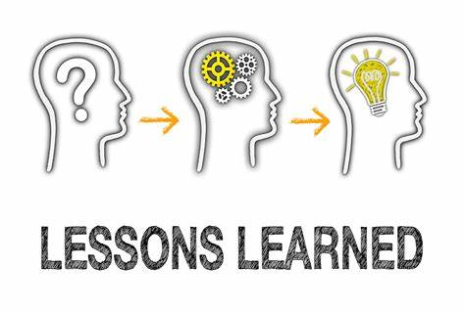
Improve
What I’ve Learned
A good number of my variables were not statistically significant outside of Intensity of workout.
My SQL improved drastically from just eliminating Low Intensity workouts and focusing only on Medium and High Intensity workouts.
It doesn’t really matter if it’s a Medium or High workout I participate in daily, as long as it’s not a Low Intensity workout.
Length of workout doesn’t necessarily have any impact on weight loss.
Cutting out unnecessary activities, such as TV, can drastically increase my weight loss.

Slide 15
Control
Next Steps
Next steps:
Continue tracking weight daily and to determine if the changes made are having an affect on the target problem I am attempting to solve.
Make sure a Medium or High Intensity/Activity is performed each day.
Continue to monitor the trend shown in the 2-week improvement period to see if results change at all.
Conclusion:
The before and after graphs show the difference when changes were implemented into my daily routine.

